Slide 1
A Critical History of the Taiwan Independence Movement, in Long Perspective
Linda Gail Arrigo艾琳達
Taipei Medical University, retired
linda2007@tmu.edu.tw 0928-899-931
Prepared for presentation at
University of Tuebingen, ERCCT
November 5, 2015

Slide 2
This PowerPoint presentation is intended to provide a summary of the text
“A Personal Account of the Taiwan Independence Movement, its History in Long Perspective, and a Retrospective Analysis”
By Linda Gail Arrigo 艾琳達, draft Octobeer 2015

Slide 3
History: Critical and Sympathetic
This is a history critical of the Taiwan independence movement (TIM), 1920’s-present.
It is critical from a leftist analytical perspective, that the participants did not dare confront the nature of United States imperialist control that supported the oppressive Chiang regime.
It is sympathetic in that it describes people I know and respect, and provides cameos of some unusual biographies to illustrate the sources of motivation.

Slide 4
Taiwanese vs. Chinese Nationalism
It highlights the points of struggle and contradiction, e.g. between Taiwanese and Chinese nationalism, and between class ideologies and the imperative to mobilize mass support for disruptive change.
Because of martial law till 1988, most of the ideological struggle was only visible among the overseas communities of Chinese and Taiwanese.

Slide 5
“Republic of China” in Limbo
“The Republic of China (ROC)” was frozen
first by United States Cold War interests in isolating the Peoples Republic of China and
second by the Shanghai Communiqué of 1972,
thus supporting the Chiang dictatorship.
TIM efforts have been limited to familiar modes of protest entirely within a simple and pro-American framework and ideology. This is overdetermined by dependent Taiwan economic devel-opment, and the conservatism of the dominant Taiwanese-Americans.

Slide 6
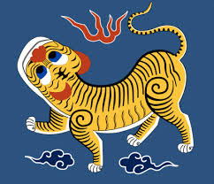
Tiger Flag, 1895

Slide 7
Japanese Colonial Period - 1
Japanese colonialism in Taiwan (1895-1945) brought development – irrigation, railroads, communications, public health and education – far beyond the general condition of China.
But it began with a bloodbath of an estimated 50,000 Taiwanese deaths in the Japanese conquest; Taiwanese were second-class citizens and often abused by Japanese police. Japan controlled most of the economy, though Japanese farmers failed.
However, especially after the 1930’s policy of assimilation, Japan did extend some rights of citizenship and orderly legal processes, and promised future representational government.

Slide 8
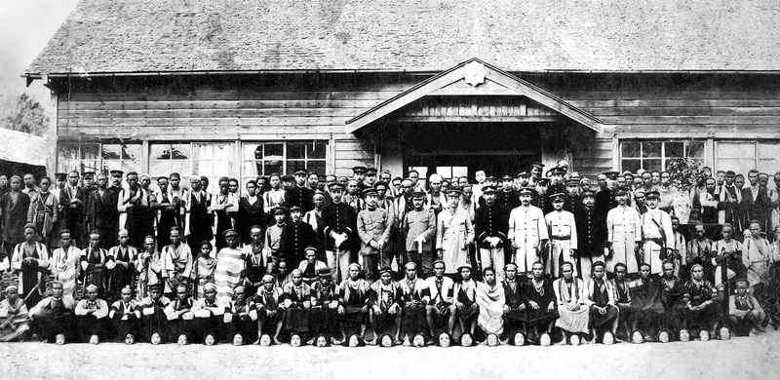
Commemorative photograph at the Musha Branch Office of Japanese colonial police in Taiwan with Atayal people and the heads of Salamao people killed at the behest of the Japanese (1920). Photograph courtesy Lin Zhicheng 林致誠 and East Asia Popular History Exchange, Taiwan.
http://www.japanfocus.org/-Jordan-Sand/4089/article.html

Slide 9
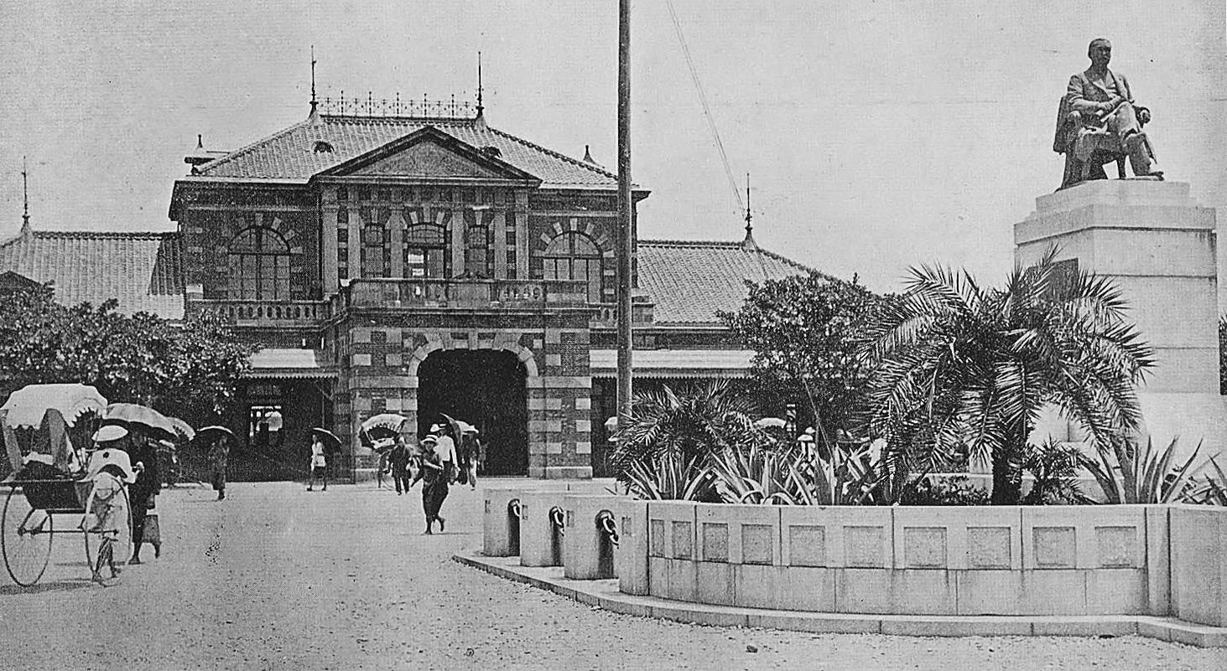
Railway station 1901

Slide 10
Japanese Colonial Period - 2
The winds of international anti-colonial movements also influenced Taiwan.
Elite landowners such as Lin Hsien-tang sought revival of Taiwanese culture as well as the right of Taiwanese to run businesses.
Leftist nationalists such as Dr. Chiang Wei-shui rallied farmer and workers’ movements. Leftists were in the majority; underground communists.
But after Japanese suppression, open activity was merely annual trips to petition the Japanese Diet.

Slide 11
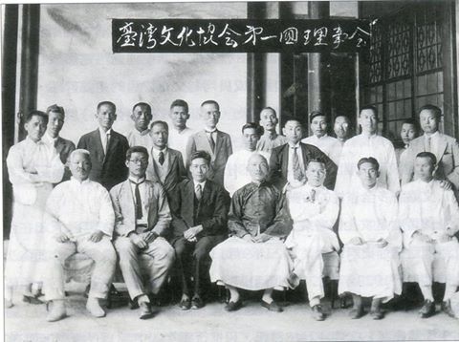
Taiwan Cultural Assn, 1920’s

Slide 12
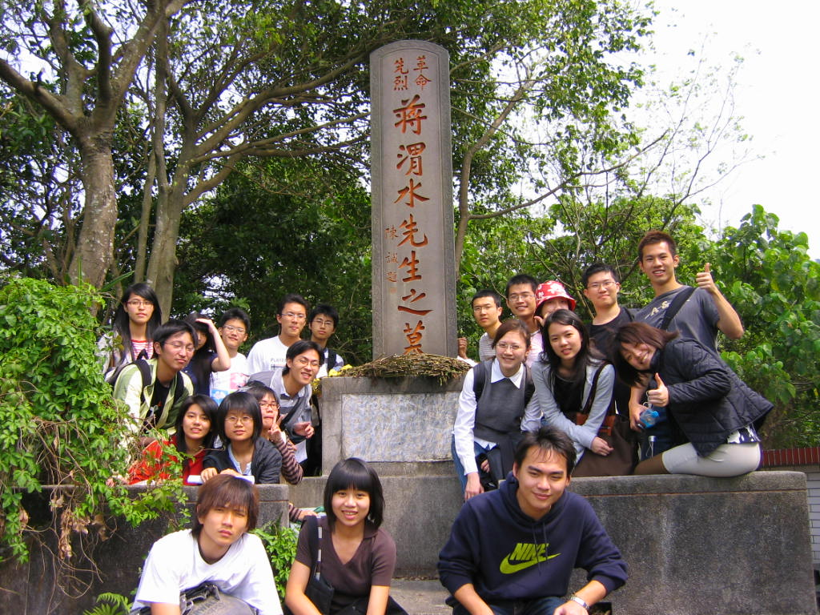
Chiang Wei-shui, 1890-1931

Slide 13
Japanese Colonial Period - 3
Some Taiwanese elites went to China to renew their cultural roots, like the scholars of old.
As Japan occupied Shanghai and North China in 1937, some Taiwanese were recruited to assist Japanese rule through their language skills.
A few anti-Japanese Taiwanese activists joined the Kuomintang in South China and Nanking (e.g. the father of Lien Chan),
or the Chinese Communists (e.g. Su Beng).

Slide 14
Post WWII: 2.28.1947 - 1
Taiwanese initially welcomed the troops of the Republic of China – but were in for a rude awakening to the nature of their imagined motherland, ruled by Generalissimo Chiang Kai-shek.
Civil protests were put down with bloodshed, and then all-out massacre and rampage after troops were sent from China on American ships. Executions, bodies floating, at Keelung Port. Deaths now estimated at 18,000.

Slide 15
Post WWII: 2.28.1947 - 2
Thousands fled to Hong Kong and Japan.
Taiwan Communist Party members such as founder Ms. Hsieh Hsueh-Hong 謝雪紅 and Su Hsin made their way to the PRC after 1949.
However, they were kept only as tokens of Taiwanese representation in the CCP and lost all ties to Taiwan; during the Cultural Revolution they were severely criticized for narrow separatism, and Hsieh died prematurely.

Slide 16
Post WWII: 2.28.1947 - 3
Elites that fled to Japan, such as Liao Wen-yi 廖文毅 (William), founded the Taiwan Provisional Government 臨時政府. Liao was close to General McArthur.
William Liao attended the 1956 Bandung conference with the assistance of a Taiwanese-Indonesian, Tan Tie-hiong 陳智雄 (Chen Chih-hsiung). The PRC protested, Tan was deported.
Tan was kidnapped from Japan by KMT agents in 1959 and executed in Taiwan in 1963.

Slide 17
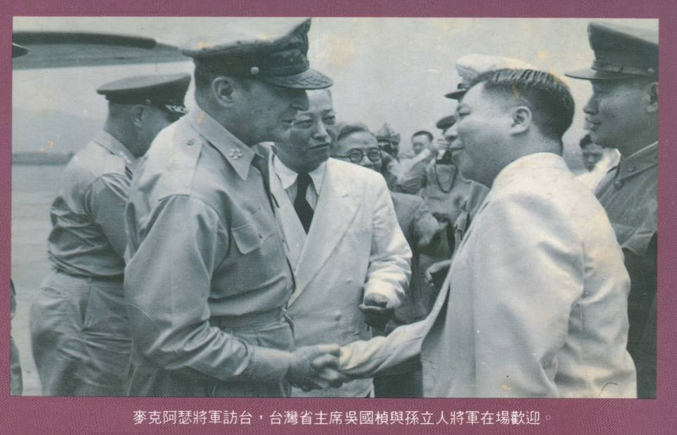
1950年7月31日麥克阿瑟訪問了台灣
囑意吳國楨主政 孫立人主軍

Slide 18
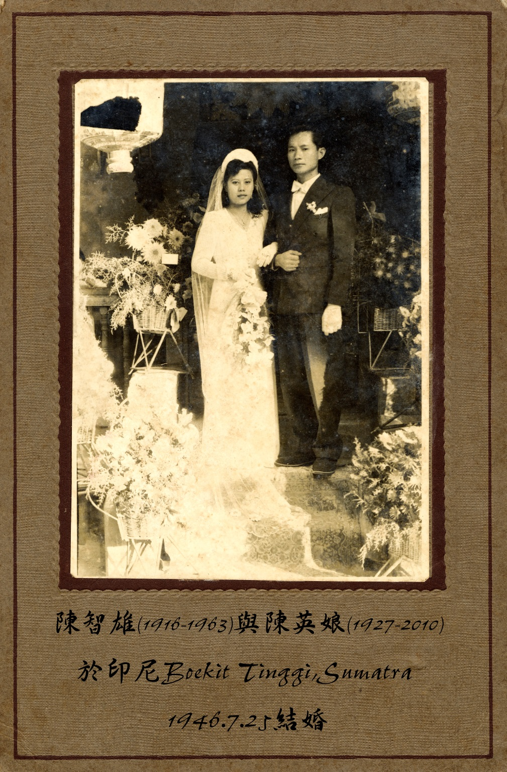
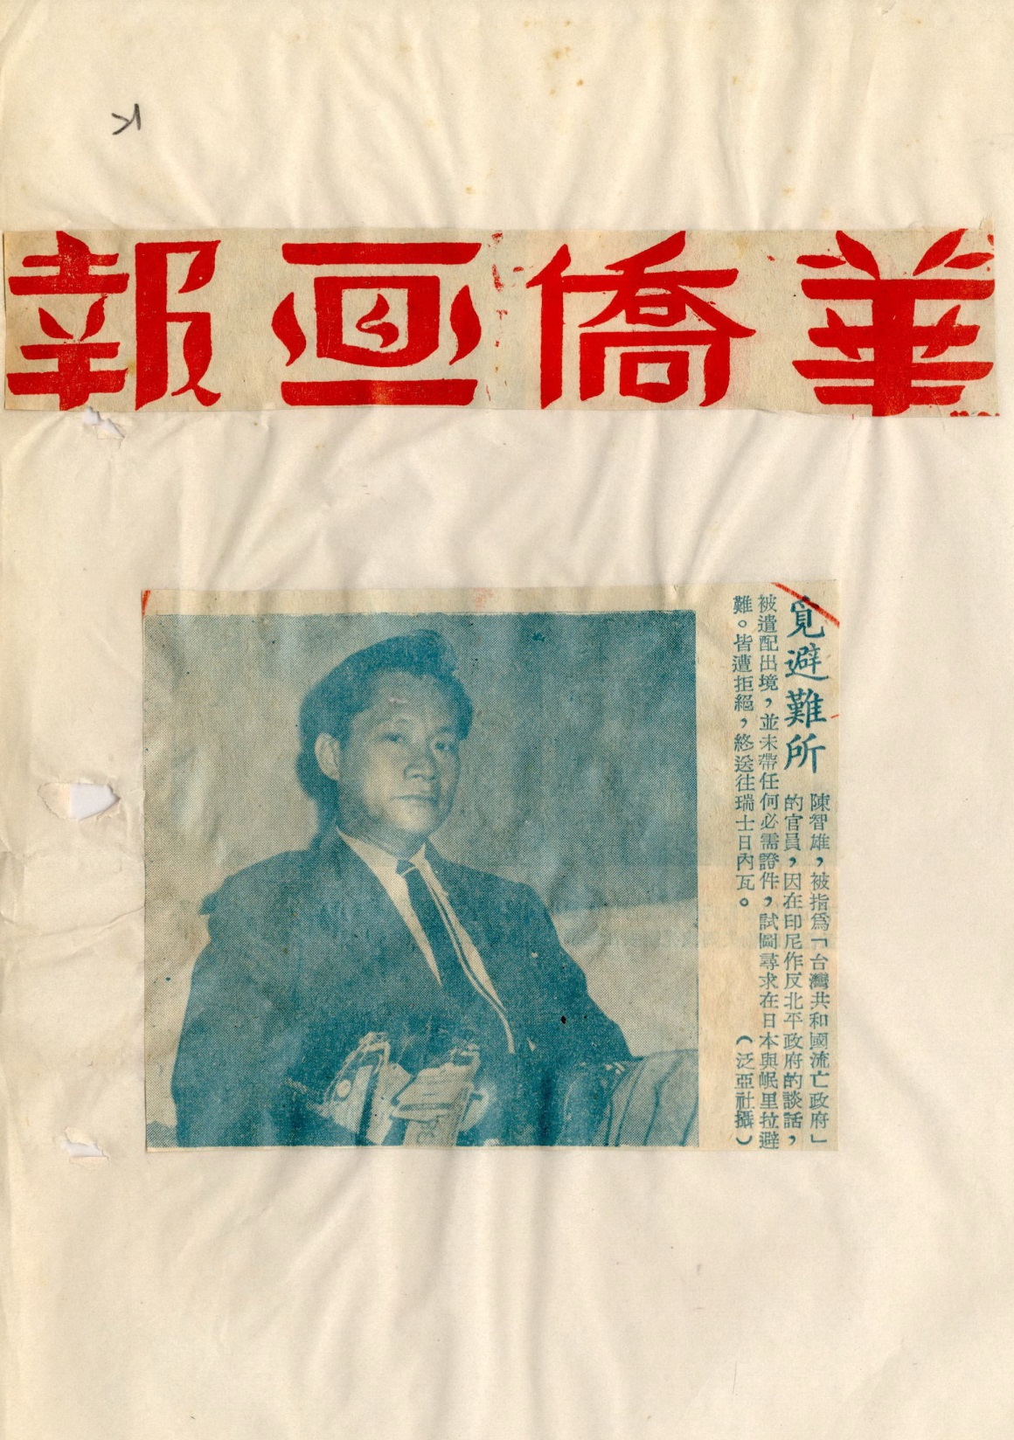

Slide 19
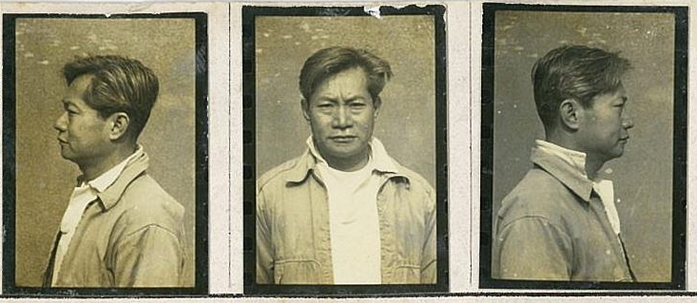
Tan Ti-hiong 陳智雄, executed 1963 for TI overseas efforts

Slide 20
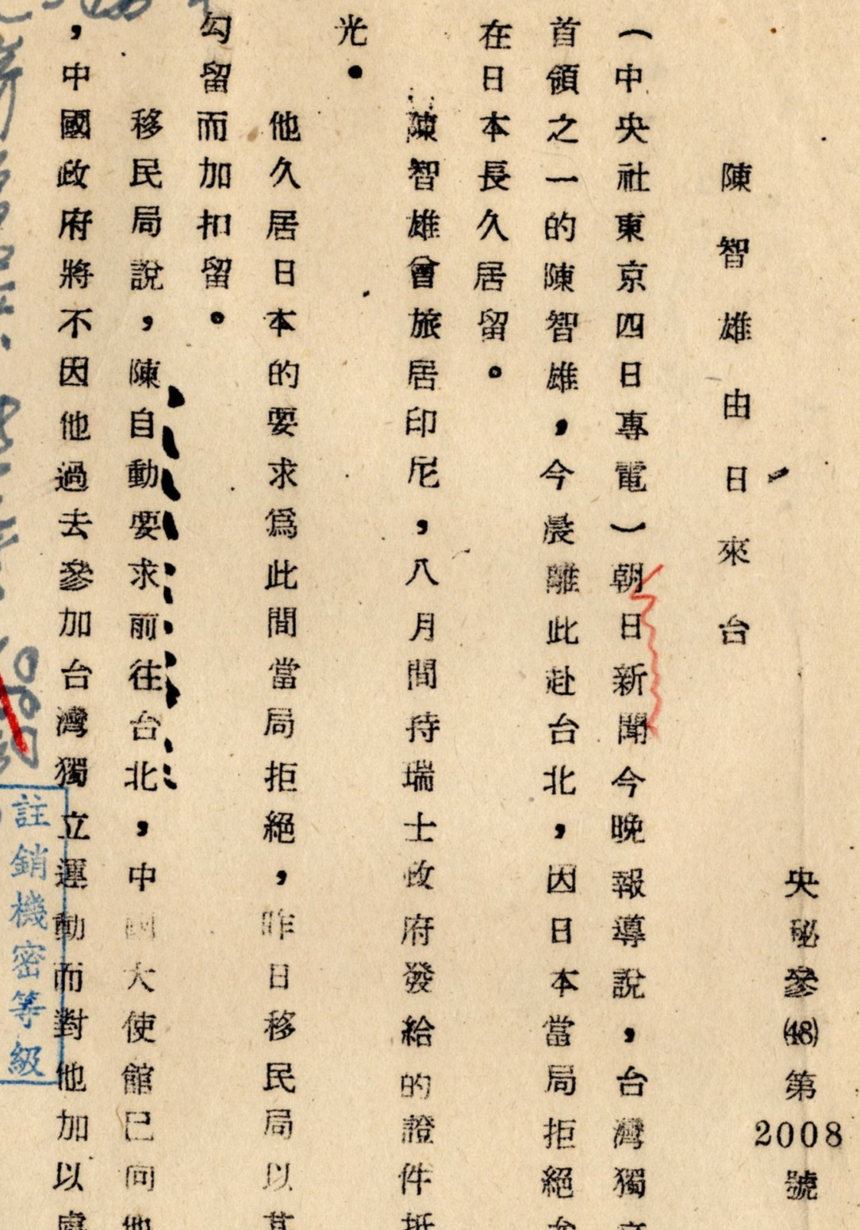
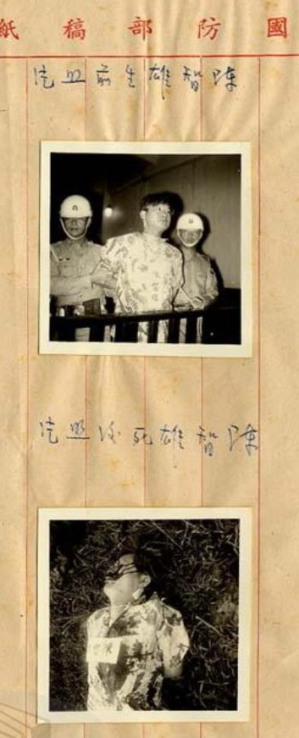
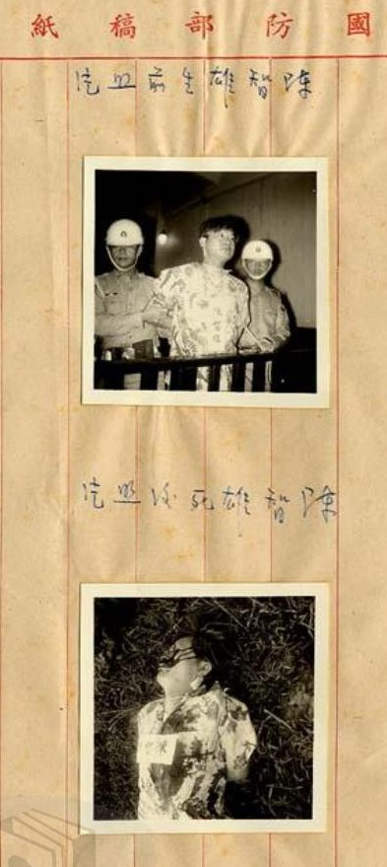

Slide 21
Post WWII: 2.28.1947 - 4
Su Beng史明 (Shih Ming, “history is bright”) had been gathering Japanese military intelligence in occupied Shanghai for the CCP; he masqueraded as a young Taiwanese dandy, with a wife assigned by the CCP – and he got a vasectomy at age 28.
Su Beng made it back to Taiwan in 1949, but had to flee in 1951 when his plan to assassinate Chiang Kai-shek was uncovered. He hid on a banana ship.
In Japan, Su Beng founded an anti-KMT intelligence network working out of his noodle shop near a Tokyo subway interchange. He wrote Four Hundred Years of Taiwan History《台灣人四百年史》in 1962, with left national liberation movement perspective.

Slide 22
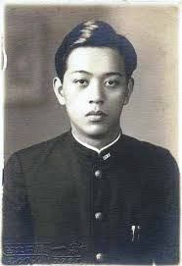
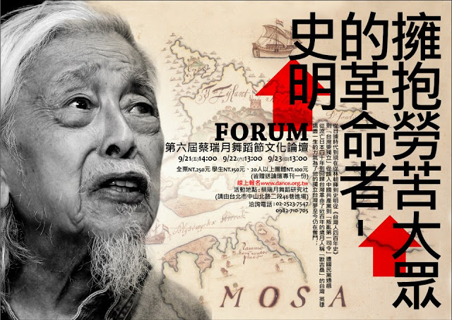
Su Beng, national liberation movement

Slide 23
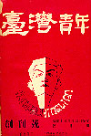
Taiwan Youth《台灣青年》創刊號
Publication of
TIM in Japan

Slide 24
The White Terror Period - 1
In 1949-52, the Chiang regime purged its enemies, real and imagined communists and anyone with a social conscience, with an est. 5,000 executions. Secret police managed by Chiang Ching-kuo and Chen Cheng.
Probably more mainlanders (e.g. Huang Rong-tsan, 2-28 artist) were executed than native Taiwanese. But easily 10-15 years imprisonment for political study group members.
Chen Cheng dedicated a monument to anti-Japanese Dr. Chiang Wei-shui only 200 meters from the graves of White Terror victims!

Slide 25
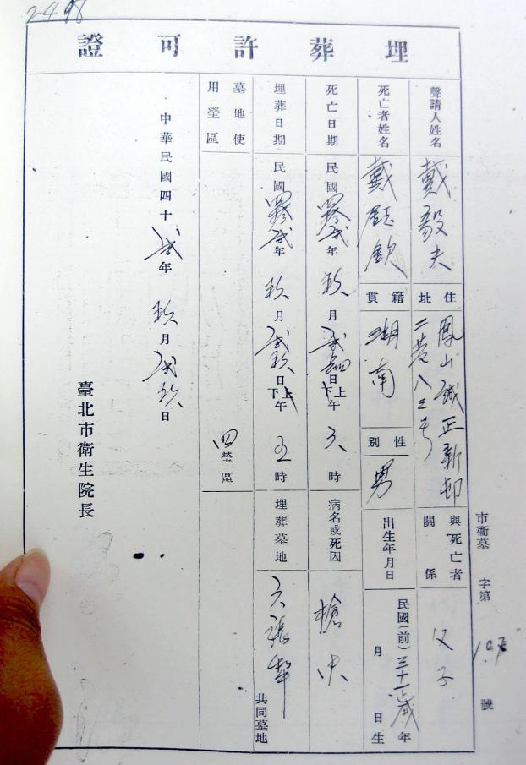
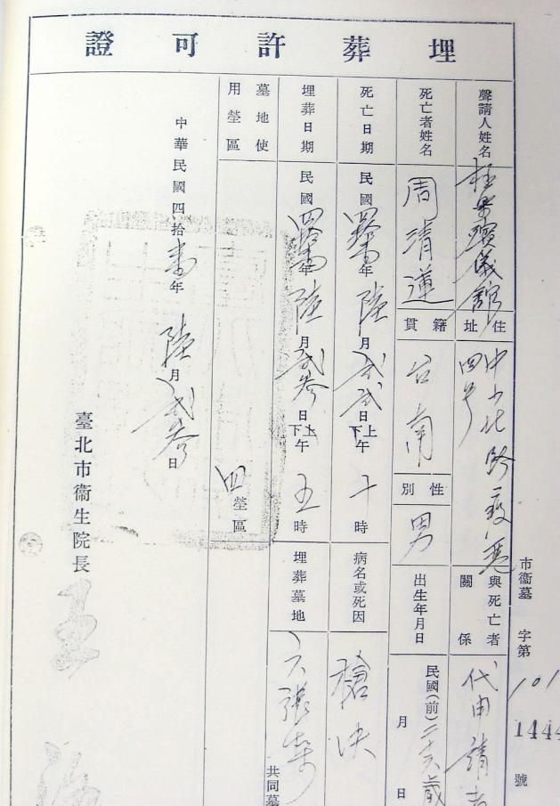
被槍決 — 埋葬許可證
Permit to bury for those executed. 艾琳達攝影2008.06.23

Slide 26
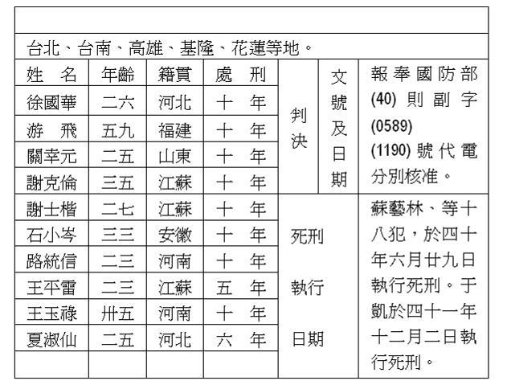
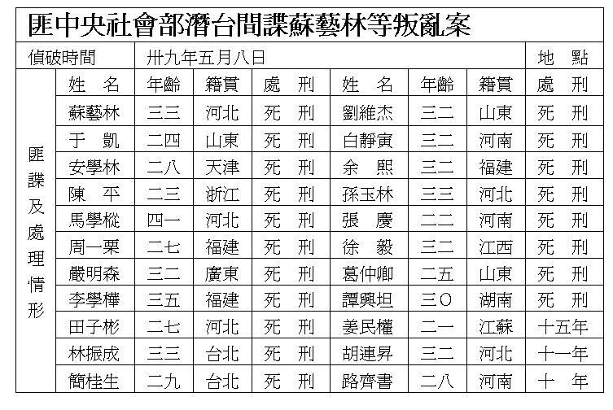
List of sentences in
Su Yi-lin case, 1951; 19 executed

Slide 27
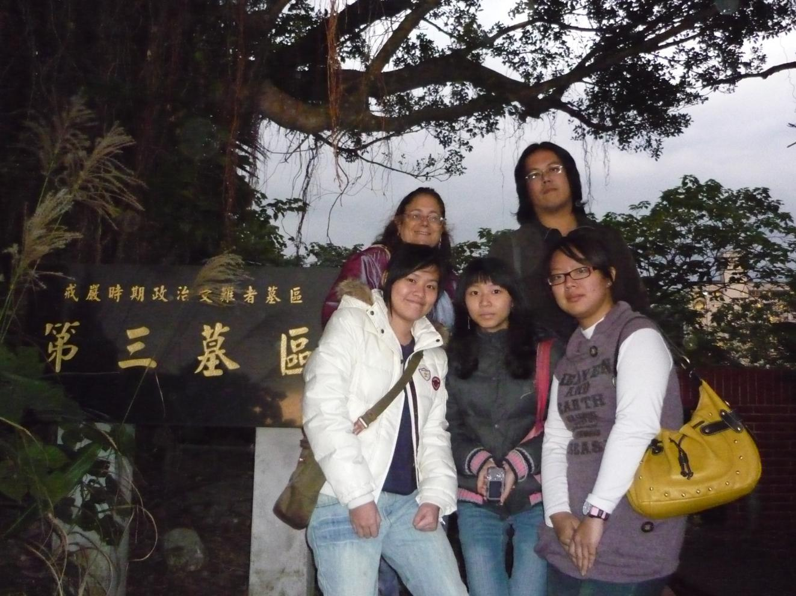

Slide 28
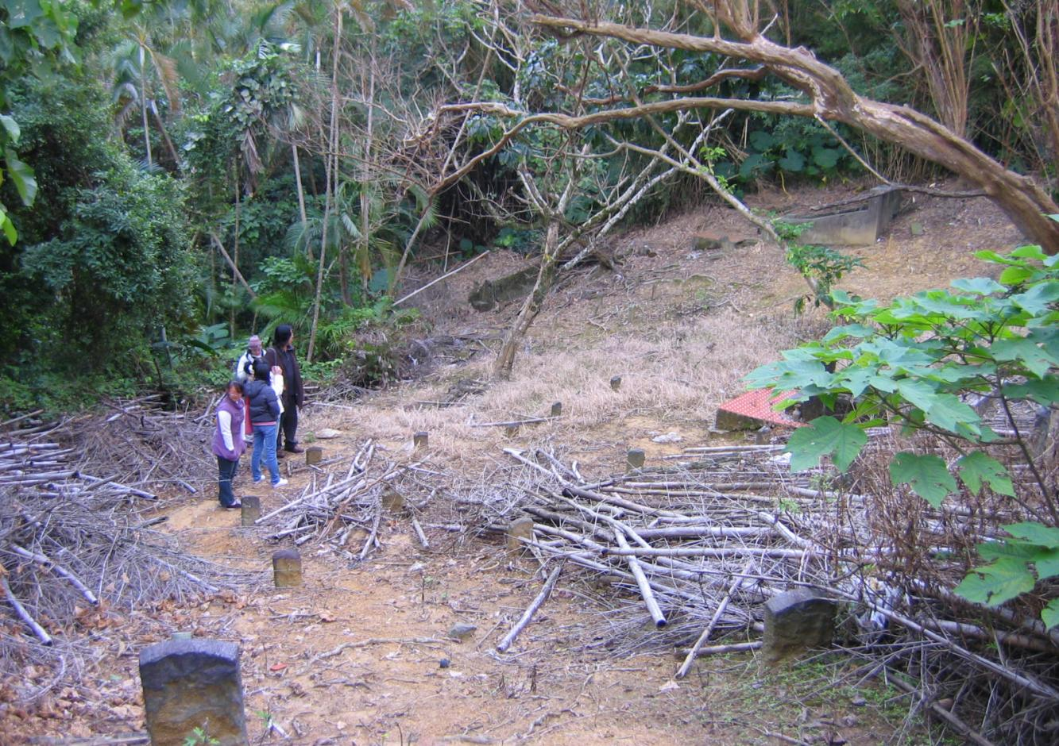
戒嚴時期政治受難者第三墓區

Slide 29
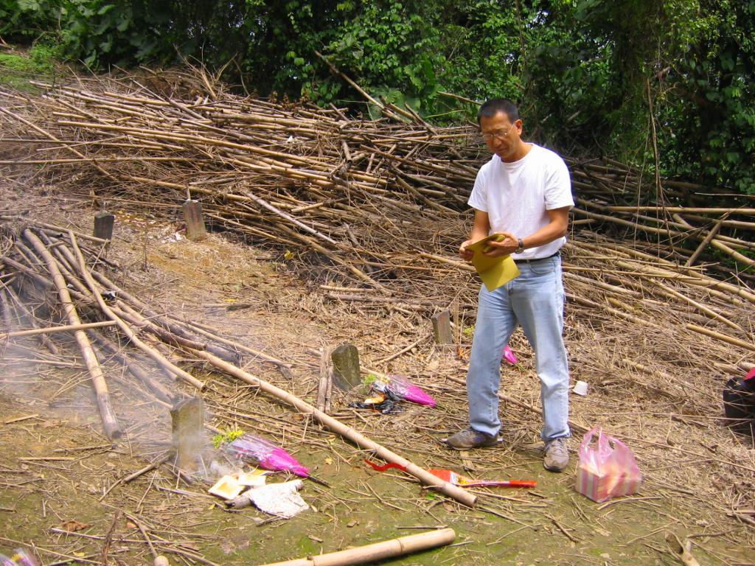
洪維健為死者燒紙錢，詢問亡靈是否可於其紀錄片中拍攝有關其槍決的內容
Hong Wei-jian burns paper money for the dead to ask their approval for his film on their execution…
洪維健，紀錄片工作者，發現1950年蘇藝林案19位槍決者中其中6位。他的媽媽因此案被判10年，爸爸13年，他在五至十歲時跟他媽媽一起在獄中生活。
Hong Wei-jian, a film maker, found six of the 19 executed in the Su Yi-lin case, 1950.
His mother was jailed 10 years in the case, his father 13; and he lived in jail with his mother from age 5 to 10.

Slide 30
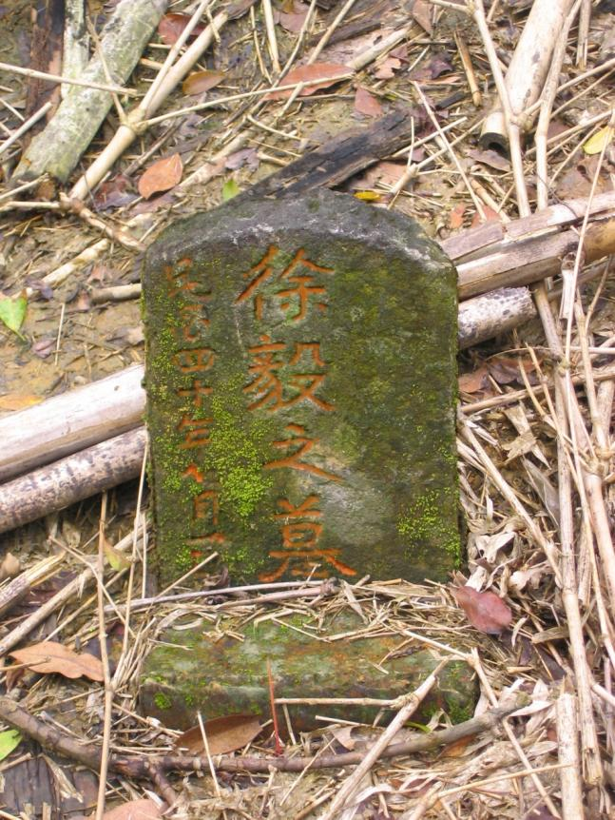
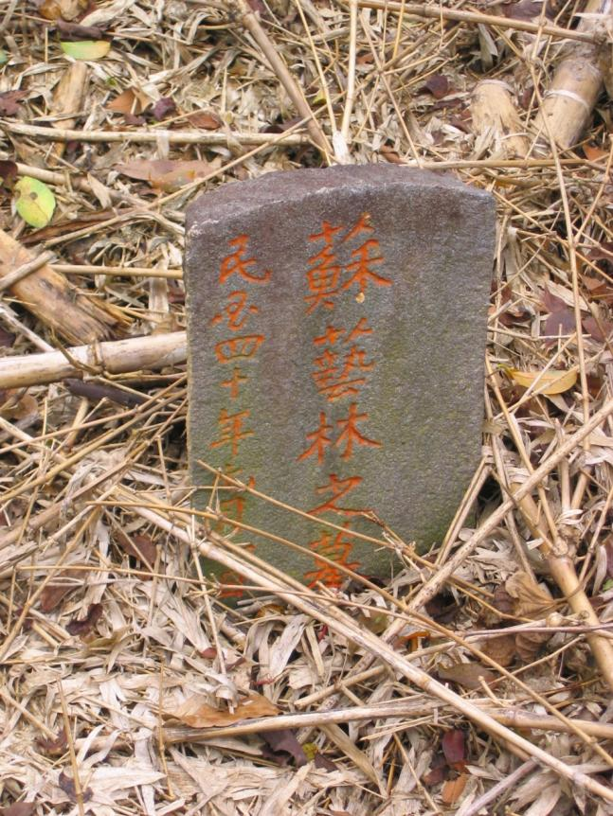
Hsu Yi and Su Yi-lin, executed 1951

Slide 31
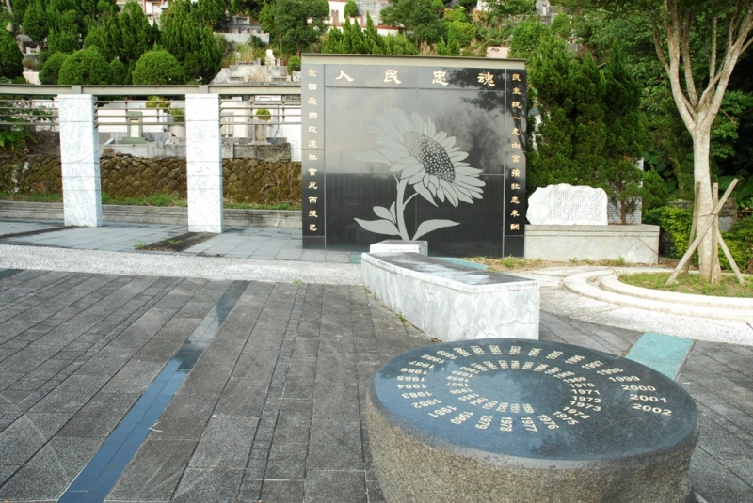
戒嚴時期政治受難者的紀念公園

Slide 32
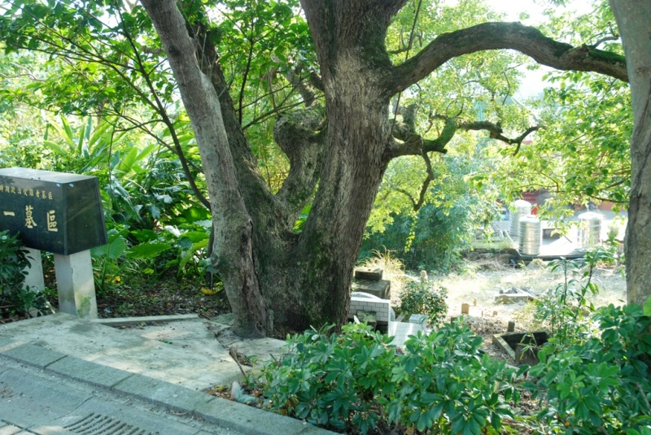
原先被遺忘的墓園—第一墓區

Slide 33
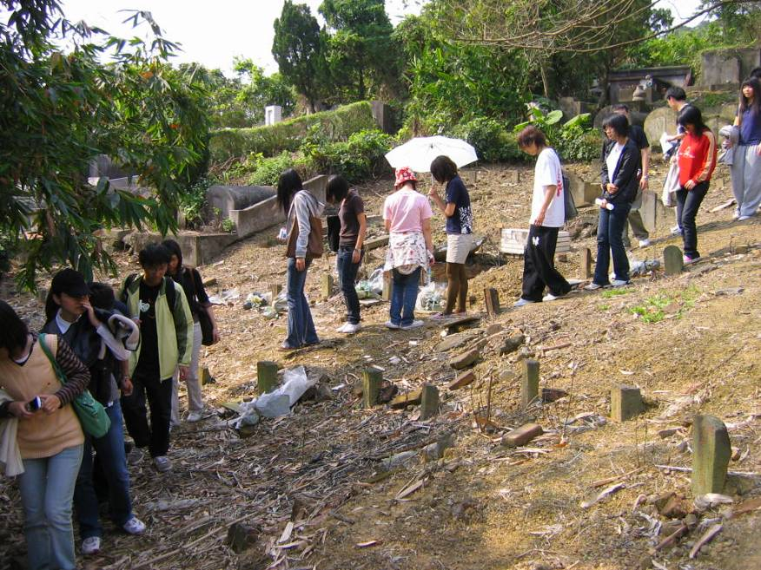

Slide 34
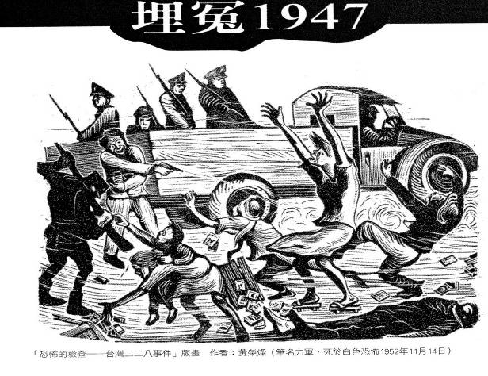
黃榮燦
當時在二二八事件之後的木刻家
「力軍」(黃榮燦)，於1947年4月28日在上海《文匯報》發表這個著名的版畫，反映了這場歷史悲劇。黃榮燦，重慶人，1952年
11月14日死於白色恐怖。

Slide 35
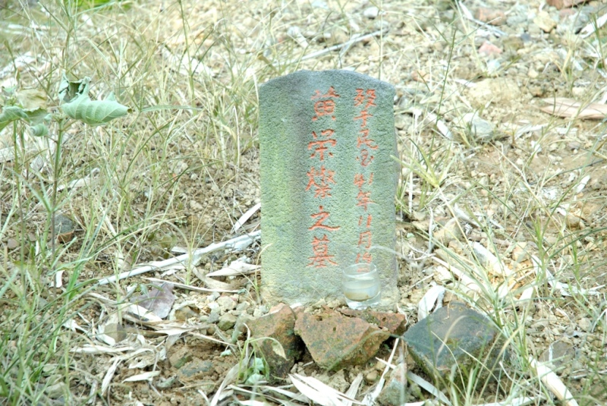
黃榮燦先生之墓

Slide 36
The White Terror Period - 2
In the 1960’s Taiwanese doctors and others training in Japan were enthused by the message of TIM, and many were jailed soon after return to Taiwan.
E.g. Dr. Chen Chung-tong 陳中統, ironically named by his father “China Unite” in the Japanese period, was sentenced to 10 years in 1967; in 1970 he played a crucial role in compiling a list of political prisoners.
From the Japanese period, doctors are often community and political leaders in Taiwan.

Slide 37
Taiwanese Migration Patterns - 1
Taiwanese in Japan tended to carry on the elitist pattern of the colonial period, when rich Taiwanese took Japanese names to underscore loyalty and assimilation, and sent their children to study medicine and professions in Japan.
Taiwanese in Japan were also constrained from open political participation by rigid Japanese laws limiting citizenship rights, and governmental cooperation with the KMT –
at least 5 Taiwanese activists were kidnapped from Japan by the KMT.

Slide 38
Taiwanese Migration Patterns - 2
In the mid-1960’s, Taiwanese educated in science were given scholarships to the United States in large numbers due to the U.S. “brain drain” – rapid science development for military and space exploration. In 1960-69 18,200 out of 20,800 students going abroad, i.e. 83%, were going to study in the U.S.
This led to a shift in TIM leadership from Japan to the U.S. Most students obtained jobs in the military-industrial complex, leading to a conser- vative upper middle class pro-U.S. outlook.

Slide 39
Taiwanese Migration Patterns - 3
In the mid-1960’s to 1970’s, large numbers of working-class Taiwanese migrated to Brazil, Paraguay, and Central America.
Most were able to establish small businesses, and educate their next generation as professionals, especially doctors. Some professionals re-migrated to the U.S. So we have Taiwanese with Spanish first names.
These South and Central American migrants were more leftist than the U.S. migrants, and many affiliated with Su Beng. Europe likewise.

Slide 40
The Diaoyutai Movement, 1970
The Diaoyutai Movement arose in 1970 among mostly ROC mainlander students abroad to protest the U.S. including the Senkaku Islands (Diaoyutai) in Okinawan territory returned to Japan. It claimed the islands belonged to China.
Although the participants were often the children of KMT officials, the movement marked a rebellion against ROC ideology and a turn to the PRC. It aired the dirty laundry on Chiang Kai-shek and distributed PRC tracts.

Slide 41
Assertion of Taiwanese Identity
By 1968 TIM activists had put together a U.S. national mailing list for TIM mimeographed newsletters. (Hong Dze-sheng, aka Cary)
In 1970-71 Taiwanese community groups speaking Hokkien dialect began to form in major US cities and college towns, despite attempts at infiltration and intimidation by overseas KMT agents.
The World United Formosans for Independence 「台灣獨立建國聯盟」, or WUFI, emerged in 1970 combining Japan, Canada, U.S., Europe and later Brazil, but mostly led from New York.

Slide 42
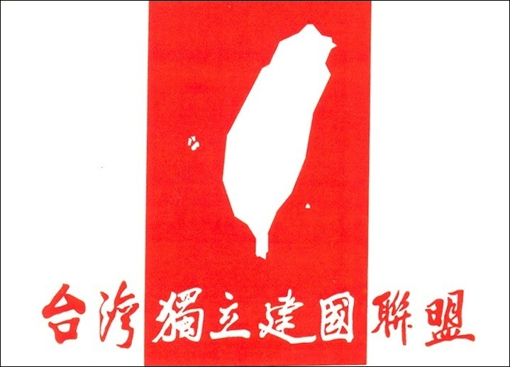

Slide 43
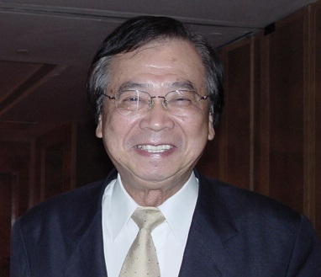
George Chang, WUFI chairman

Slide 44
The Escape of Peng Ming-min
The escape of Peng Ming-min 彭明敏 from Taiwan to Sweden in January 1970 excited TIM sentiments.
In September 1964 Peng, an internationally-known professor of aviation law, tall and missing one arm after the American bombing of Nagasaki, tried to print “The Taiwan People’s Declaration of Self-Salvation”, together with former students Hsieh Tsung-min謝聰敏 (Roger)& Wei Ting-chao 魏廷朝.
International outcry led to Peng being released from prison to house arrest after only four years; his escape escapade was engineered by American missionaries.

Slide 45
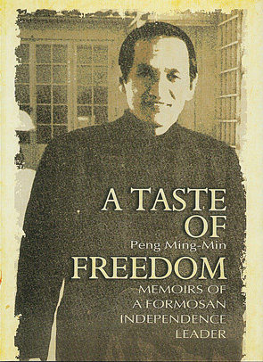
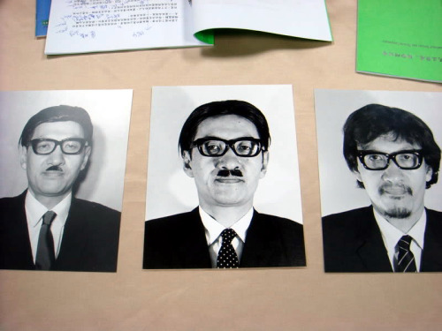
Peng Ming-min disguised for his escape.

Slide 46
Attempt to Assassinate CCK
On April 24, 1970, a Taiwanese graduate student in sociology at Cornell University, Huang Wen-hsiung 黃文雄 (Peter) attempted to shoot heir-apparent Chiang Ching-kuo 蔣經國 at the New York Plaza Hotel during his visit to the U.S., but narrowly missed.
Peter Huang had actually developed his plan in consultation with the leftist American organization Students for Democratic Society, an organization that may have also assisted his disappearance while out on bail.

Slide 47
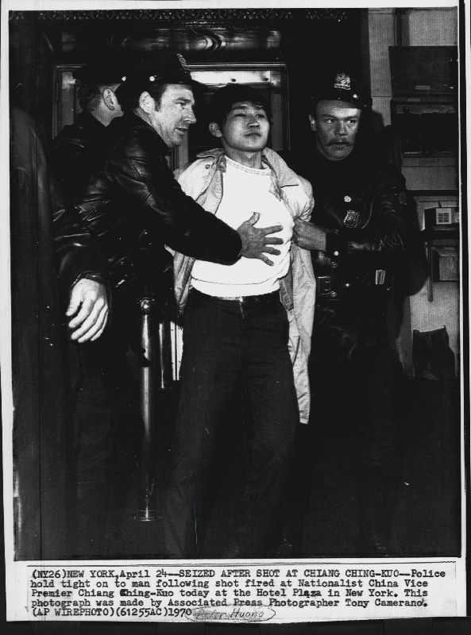
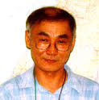
Peter Huang
黃文雄seized after attempt to shoot CCK, April 24, 1970

Slide 48
The U.S. Needs a Strongman?
In 1980, Carl Ford mentioned to me that the State Department had in about 1970 considered jettisoning Chiang Kai-shek for a Taiwanese independence solution, but concluded there was no suitable strongman to replace him.

Slide 49
The PRC in the United Nations
On Oct. 25, 1971, the United Nations General Assembly voted to admit the People's Republic of China as the rightful occupant of the China seat, on the UN Security Council.
The Republic of China could have kept a seat as “Taiwan”, but Chiang Kai-shek refused.
Kissinger’s China Card: the United States in 1972 acknowledged “that all Chinese on either side of the Taiwan Strait maintain there is but one China and that Taiwan is a part of China”. (Shanghai Communiqué, issued jointly by Nixon and Chou Enlai -- ironically, on February 28.)

Slide 50
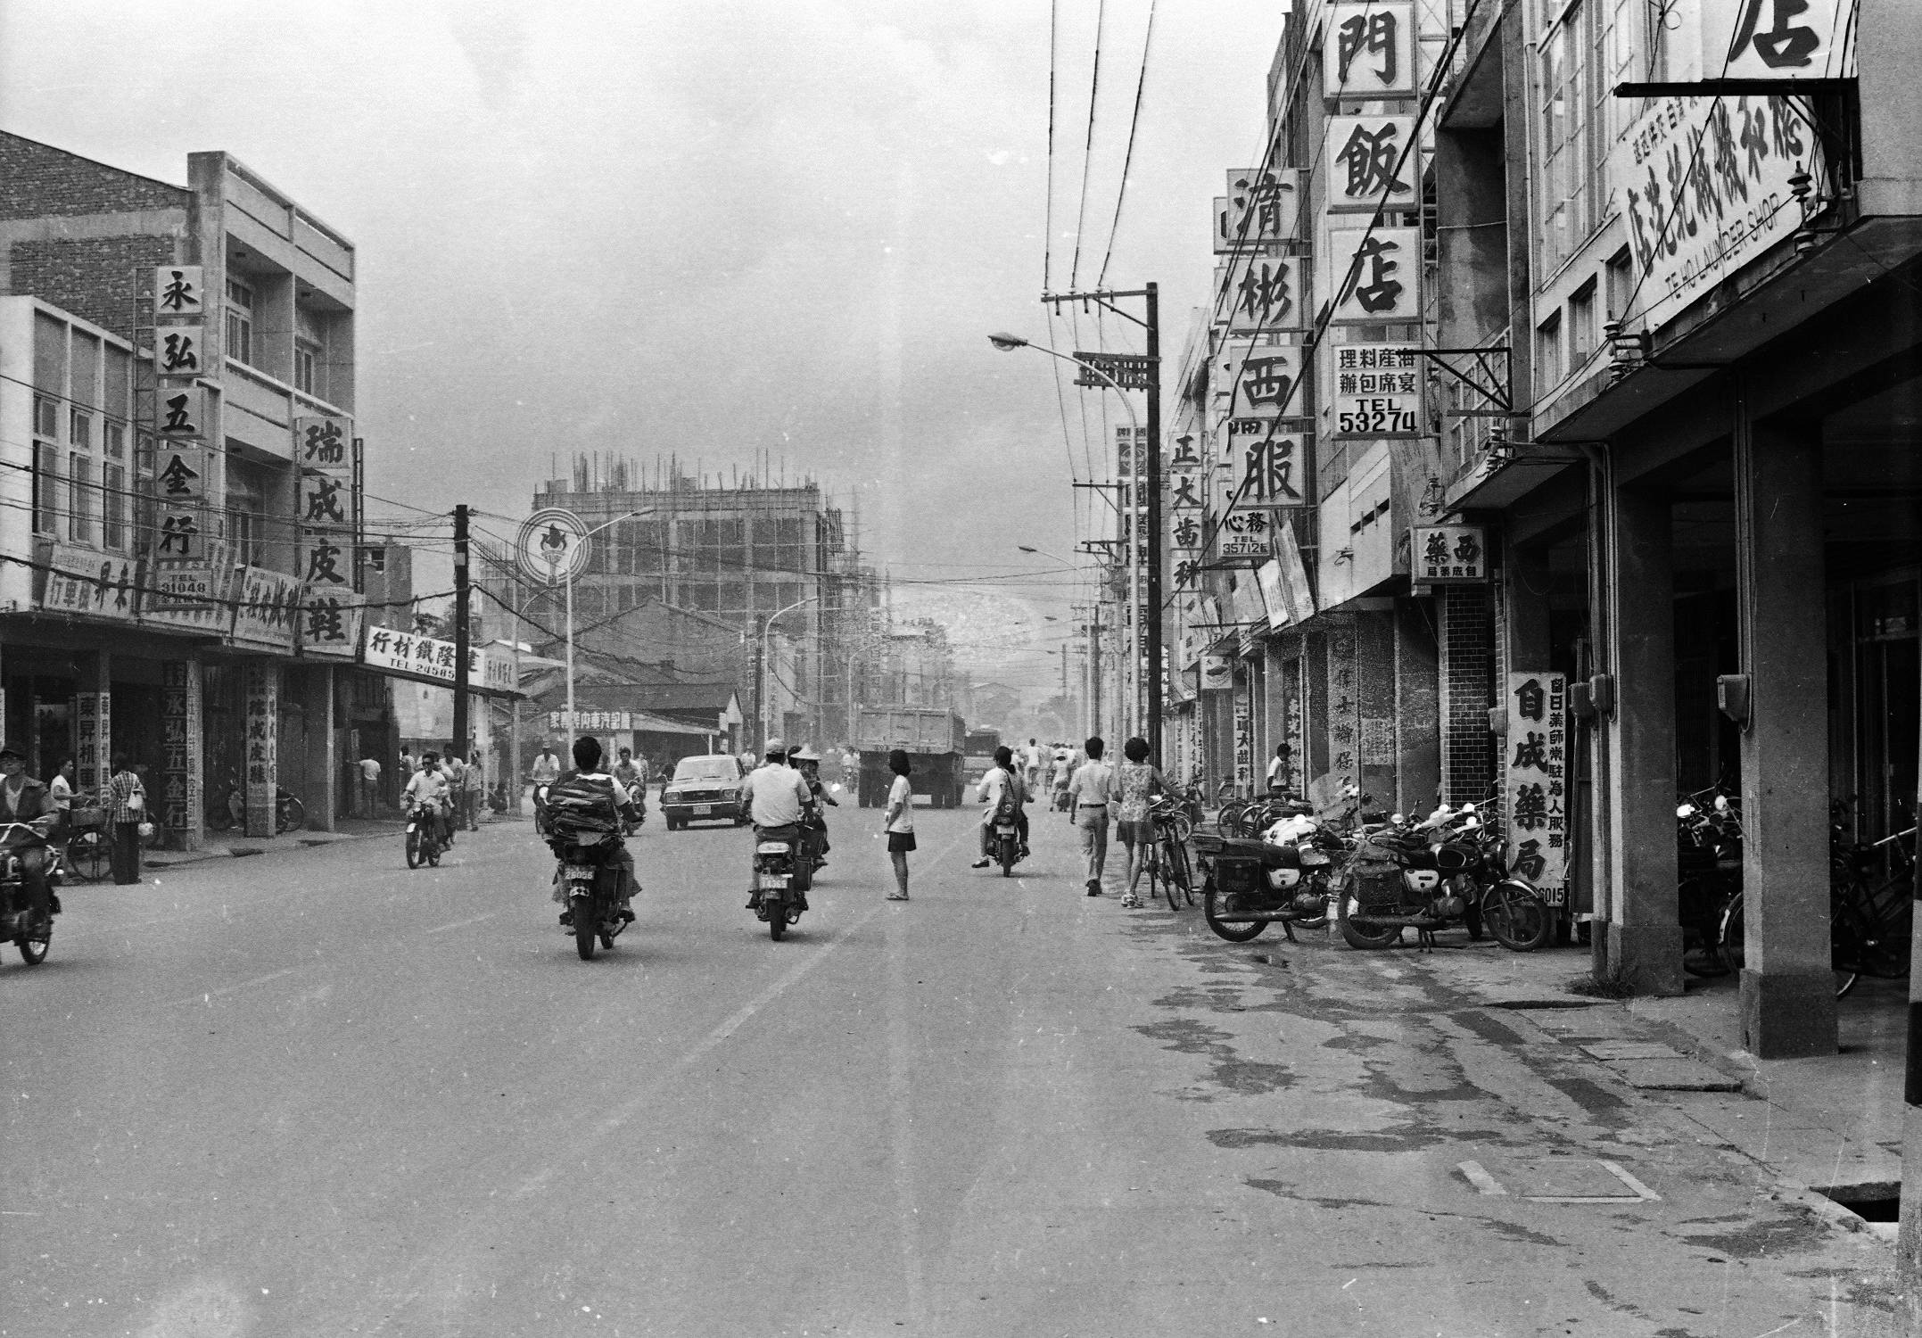
Part Two 1975-1980
Photograph courtesy of Ken Kilimnik

Slide 51
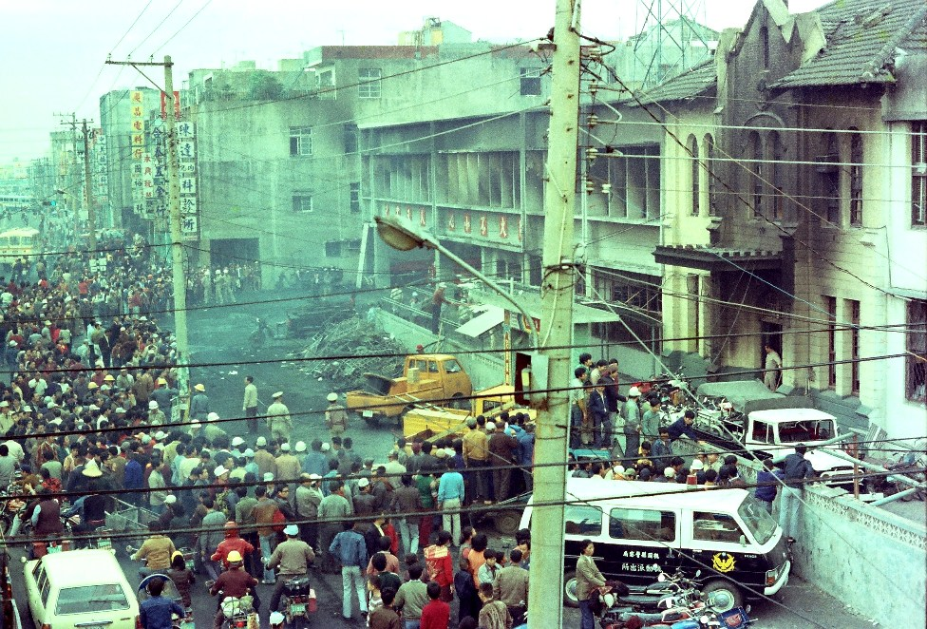
The day after the Chungli Incident of Nov 19, 1977

Slide 52
The Formosa Magazine Democratic Movement, 1978-79
The impetus for the democratic movement challenge to martial law was that it was clear that the United States would soon formally recognize the PRC.
There was a deep fear that the PRC would immediately invade Taiwan.
The movement hastened the end of martial law and opening of Taiwan to democratic process – no thanks, I would say, to the U.S., which harassed early human rights efforts.

Slide 53
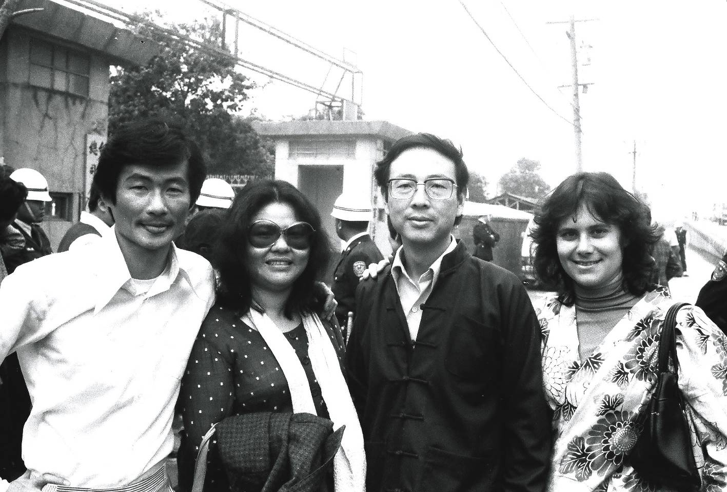
Professor Chen Ku-ying 陳鼓應, a mainlander intellectual purged from National Taiwan University Philosophy Dept in 1971, recruited foreign students for human rights reporting. In December 1978 he ran for election with the opposition coalition. Picture March 1979 at Taiwan Garrison Command.

Slide 54
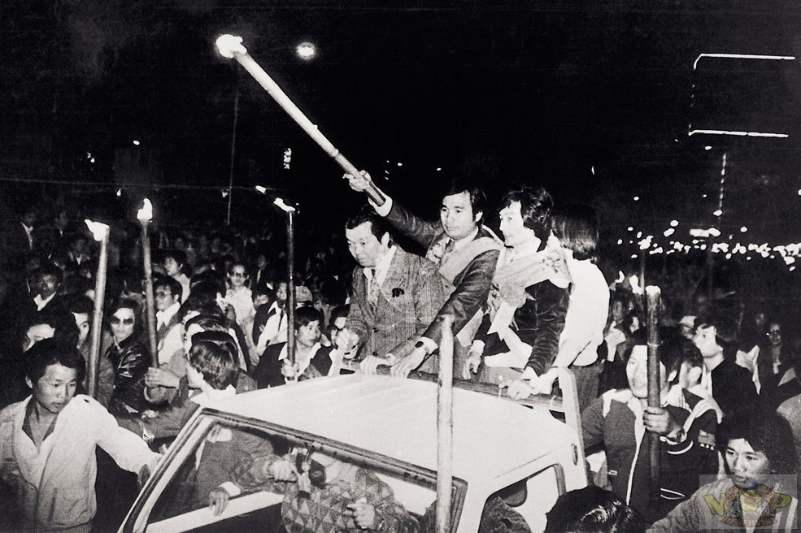
Kaohsiung Incident,
December 10, 1979

Slide 55
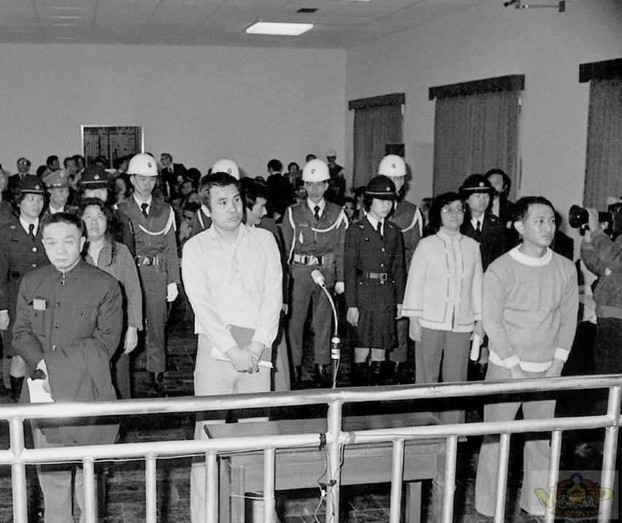
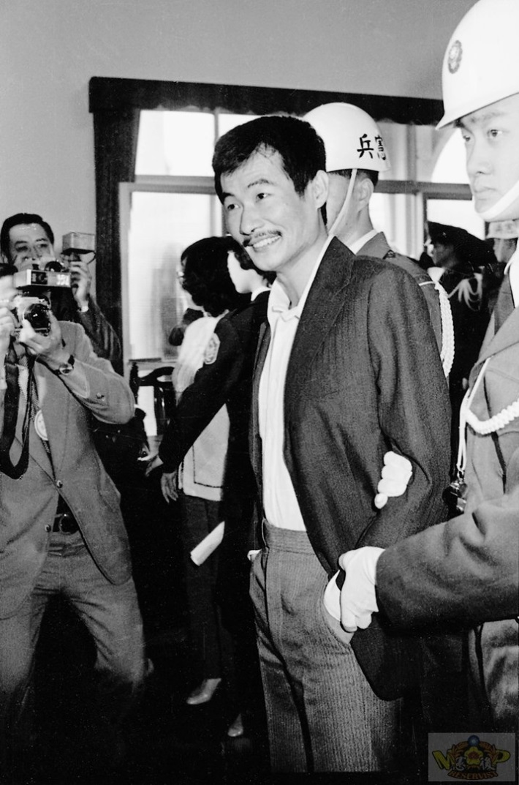

Slide 56
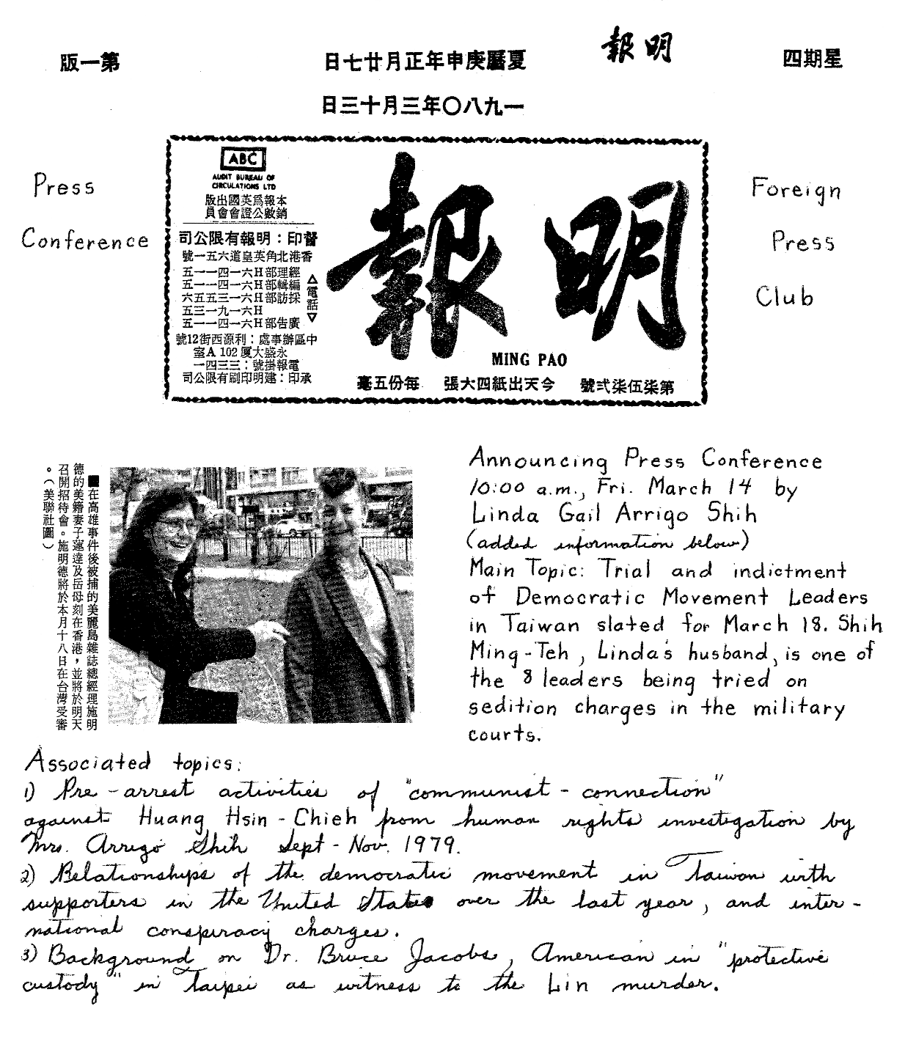
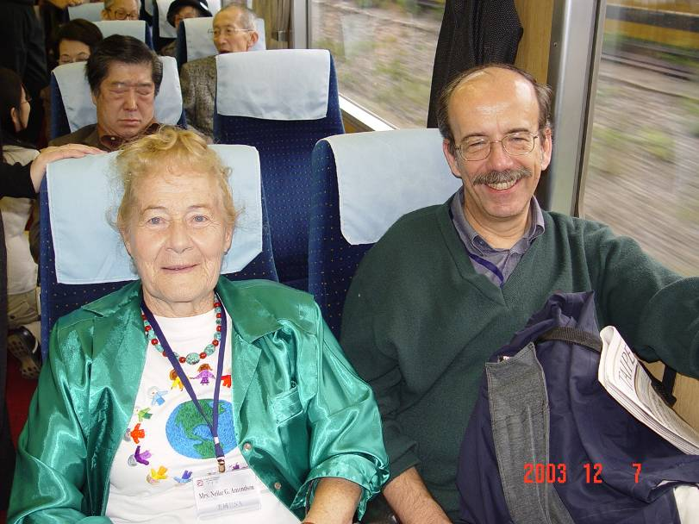
During the March 1980 trial, Linda and her mother Nellie G. Amondson in Hong Kong prepped foreign reporters and helped the wives issue appeals. Gerrit van der Wees continued Taiwan Communiqué for English information dissemination.

Slide 57
Voice of Taiwan by telephone
The democratic movement in Taiwan energized Taiwanese-Americans. And new waves of migration to the United States, Taiwanese businessmen who could get a “green card” with investment of half a million dollars, had also diversified the Taiwanese-Americans away from college towns, and brought closer contact with Taiwan.
The Voice of Taiwan, a telephone-recorded-message news network that broadcast news of the democratic movement in Taiwan daily during 1978-81, was founded in Flushing, New York, from a Presbyterian Church information service.

Slide 58


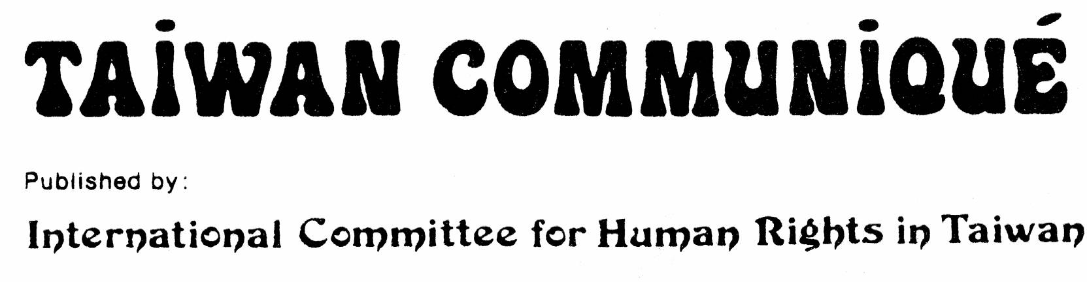

Slide 59
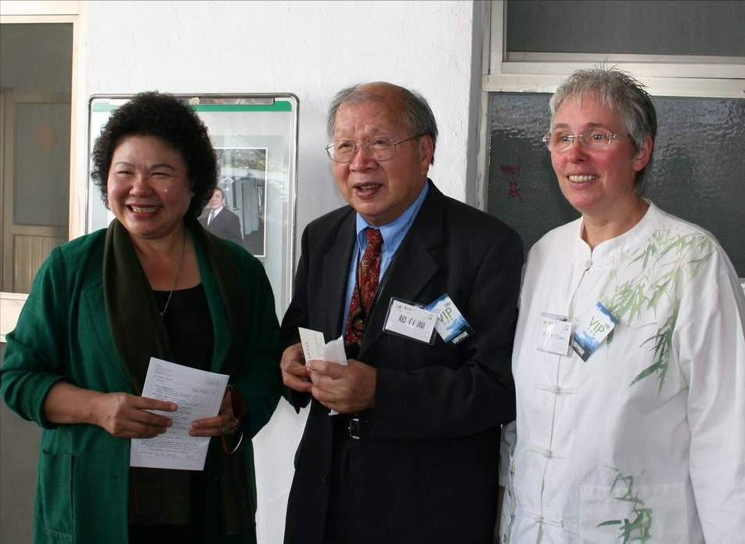
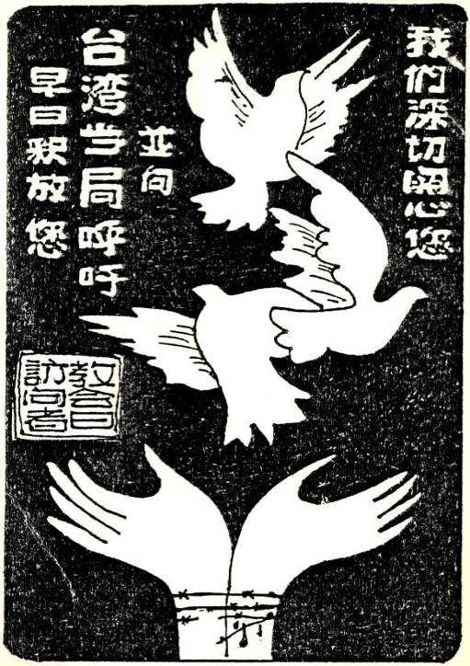
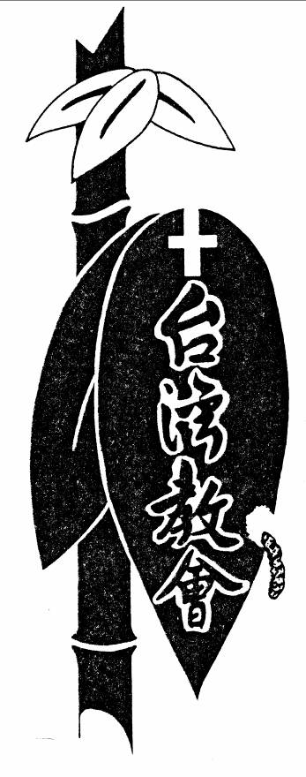
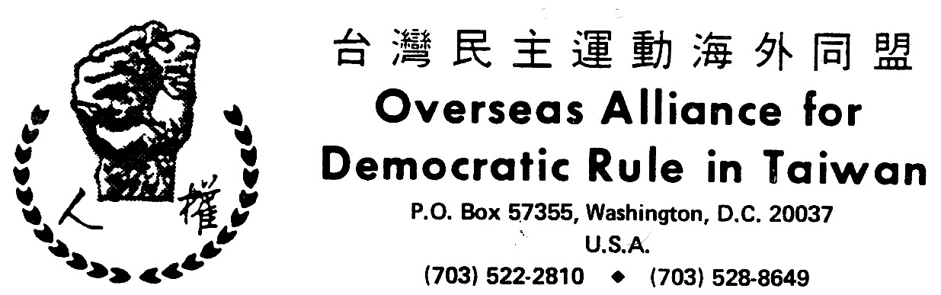
Reverend Roger Chao 超有源, Germany,
Taiwanese Christian Self-Determination Movement

Slide 60
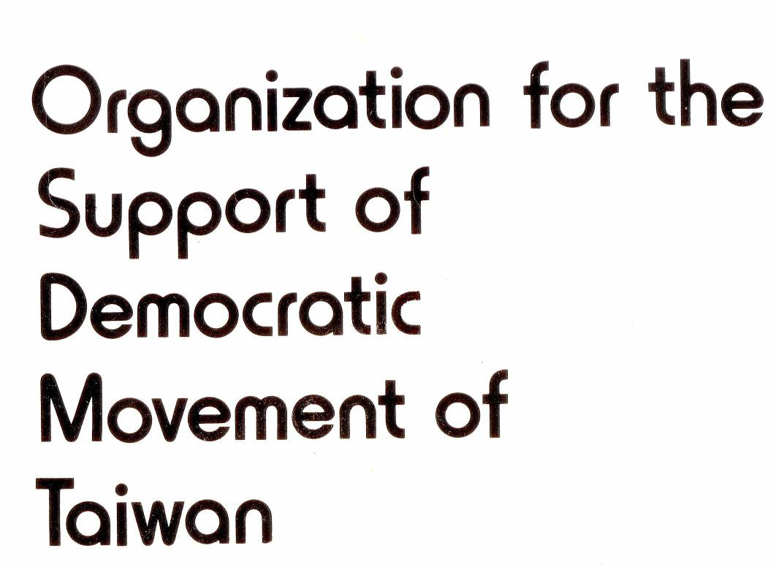

The organization of pro-PRC Lin Hsiao-hsin 林孝信 in Chicago, OSDMT 台灣民主運動支援會, about 1978-80, put together an excellent booklet reproducing documents on KMT spies on US campuses.

Slide 61
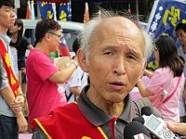
Lin Hsiao-hsin 林孝信, pro-PRC group
Lin founded OSDMT in Chicago in 1979. Most members were pro-PRC.
They tried to make China support Taiwan democracy; disappointed in 1985, Li Xiannian stmt.
Lin returned to Taiwan about 1991, founded community colleges, social activist hotbed.

Slide 62
Save Taiwan by Lobbying?
In 1980 Ronald Reagan’s lawyers Deaver and Hannaford were receiving a monthly retainer of US$5,000 from the ROC government.
WUFI and its successor Formosan Association for Public Affairs (FAPA) have put their efforts into lobbying the U.S. Congress and public.
The Washington Beltway mentality has continued to grow as a generation of Taiwanese-Americans matured, and began to feel their political space and interests within the American framework.

Slide 63
Leftist Taiwanese in the U.S.
Some Taiwanese abroad were influenced by anti-Vietnam War and social movements in the 1970’s, and about 1976 an offshoot of Su Beng’s Marxist-Leninist national liberation line formed clandestinely in the US, with the publication Taiwan Era (Taiwan Shidai). In 1980-84, it vigorously challenged WUFI, but disappeared in 1986.
Su Beng’s distinction from the conservative TIM groups is that he expressly labeled the Taiwanese bourgeoisie who cooperated with and benefited from the KMT rulers as compradors, categorized as enemies.

Slide 64
The Murder of Chen Wen-cheng
Professor Chen Wen-cheng of Carnegie Mellon University in Pittsburg was murdered during his visit to Taiwan, in July 1981. He was a prominent member of Taiwan Era. Although it was an underground organization, I believe it had about a hundred members.
I cooperated with Taiwan Era in 1980-84 to criticize WUFI and promote a leftist direction. I was at Chen Wen-cheng’s house in May 1981.

Slide 65

Chen Wen-cheng, murdered in July 1981 by Taiwan security agency

Slide 66
Hsu Hsin-liang’s Formosa Weekly
Hsu Hsin-liang left Taiwan before the December 1979 crackdown. He split with WUFI in New York to found a rival organization in Los Angeles and publish a 16-page newspaper, Formosa Weekly, first issue July 1980, with assistance from those critical of WUFI’s conservative position, including some Taiwanese in Su Beng’s network and some pro-PRC – leading to internal struggle.
Others who dared take on more open challenge to the KMT also joined up with Hsu, and a group of them later became known as the “California gang”; later in Hsu’s team within the DPP.

Slide 67

Hsu Hsin-liang and Chen Chu, 1979
(photo by Linda)

Slide 68
Splits in WUFI
Influenced by Hsu Hsin-liang’s populism and direct experience, the left wing of WUFI split off in 1984 and formed the Taiwan Revolutionary Party, which cooperated with Hsu.
This included 27 younger WUFI members, led by Cary Hong and Patrick Huang in New York.
Joshua Tin of this group designed the “Return the Party to Taiwan” gambit. Hsu was persuaded.
Cary and Patrick in about 1987 set up a safe house in Queens to teach Taiwan activists tactics.

Slide 69


Cary Hong 洪哲勝,
Patrick Huang 黃再添,
Joshua Tin 田台仁 --
Taiwan Revolutionary Party 台灣革命黨 1984, later 「海外組織」

Slide 70

Patrick and Sharon Huang

Slide 71
“Take the Party Back to Taiwan”
Events in Taiwan overtook the overseas standoff. Some Formosa Magazine prisoners, notably Shih Ming-deh, went on hunger strike in 1985, demanding that President Chiang Ching-kuo tolerate the formation of opposition parties.
Cary Hong, the California Gang, and Linda Arrigo answered their call, and set up a hunger strike activity on the lawn in front of Capitol Hill (with required police permission) for two weeks in July 1985.

Slide 72

Washington DC Hunger Strike, July 1985
Actually this is September 1980 hunger strike in LA, but DC activity looked about the same, also “California gang”.

Slide 73
Doing an “Acquino”, 1986
This action, stimulated by Acquino and Kim Dae-jung news, morphed into setting up a “Taiwanese Democratic Party” in May 1986 and planning to bring a mass of members into Taiwan, together with Hsu Hsin-liang, wanted for arrest.
The overseas group arrived in planes about Nov 30, to a huge KMT standoff with welcoming crowds at Taoyuan airport. Hsu was expelled, not arrested.
海外組織便施以壓力，表示島內的若不組黨，他們將在美國成立政黨，然後遷黨回台。與此同時，許信良、謝聰敏和林水泉等人宣佈將集體闖關回台，然後一行人搭飛機前往日本、台灣、香港等地，試圖為突破黑名單作各種挑戰。

Slide 74
Leftists lose luster…
The success of open challenge to the KMT squelched the underground revolutionary alternative, Taiwan Era.
But in the 1990’s former members of Taiwan Era returned to Taiwan to spur labor and environ-mental movements, such as Taiwan Green Party.
Ditto for some pro-PRC leftists; but in action, they often remade themselves as Taiwan nativists since pro-PRC views alienated the grassroots.

Slide 75
The Democratic Progressive Party was formed in September 1986 and not directly suppressed. Why?

Slide 76

Green Era
綠色年代1975~2000：
台灣民主運動25年，2005年 ISBN：9867108035，作者：張富忠、邱萬興

Slide 77
Out of Time! Me, Taiwan
I have not quite enough time to describe in detail the ideological and political struggles of the 1980’s and 1990’s! See Linda Archives, etc.
But the basic fact was already set that the U.S. is hostile to Taiwan self-determination, and uses Taiwan as a pawn in China relations.
And TIM organizations have become in-creasingly conservative after 1991, and will not challenge the U.S. The Democratic Progressive Party has given up on any long-term vision.

Slide 78
Taiwan a state of the US?
台灣建州運動發起人 周威霖 David C. Chou
Founder, Formosa Statehood Movement
(an organization devoted in current stage to making Taiwan a territorial commonwealth of the United States)
來自台灣的周威霖（David Chou）到美國2年，全力宣傳台灣建州運動（Formosa Statehood Movement），通過向美國政要和精英闡述他的理念，並且已經獲得部份支持，周威霖認為，台灣建州是一項長久的運動，需要等待時機。

Slide 79


周威霖
David C. Chou
- See more at: http://mobile.chinesedaily.com/plus/view.php?aid=83477#sthash.C9WyAcyx.dpuf

Slide 80
Sequel:
See “Chinese Python Swallowing the Taiwan Frog” about Chinese infiltration of Taiwan,
Linda on John Sullivan’s blog, 2011.
Linda Gail Arrigo 艾琳達
linda2007@tmu.edu.tw

