Slide 2
Vacation at Pocono Mountain, PA
August 5 to August 12, 2018
Sunday to Sunday
(fixed schedule)

Slide 3
Housing
A two-bedroom unit
family room
Kitchen
3 bathrooms
Accommodate 6 persons & plus

Slide 4
Local interests
hiking, fishing, swimming,
whitewater rafting, tubing,
horseback riding,
visiting vineyard, winnery & brewery,
visiting farm market, museums,
visiting Bushkill Falls,
or bring your children and grandchildren
to waterparks of camelbeach or Kalahari ......

Slide 5
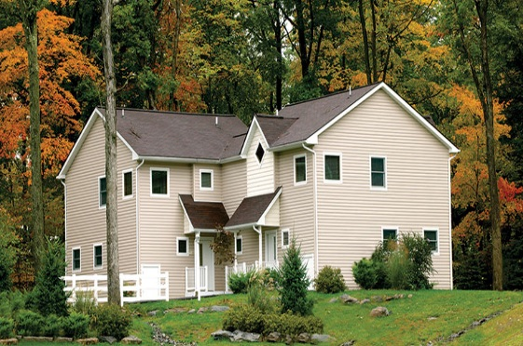
House in the wood

Slide 6
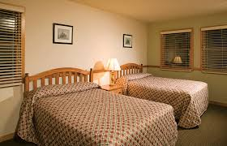
Bedroom 1

Slide 7
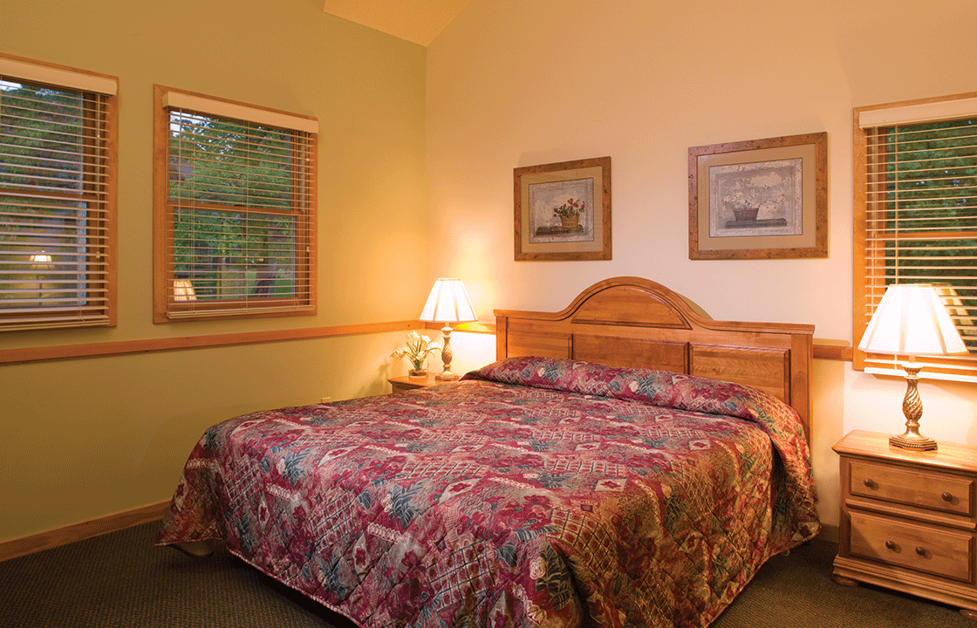
Bedroom 2

Slide 8
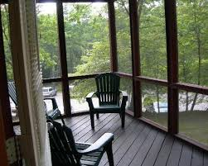
Porch

Slide 9
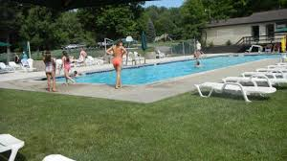
Nearby Swimming Pool

Slide 10
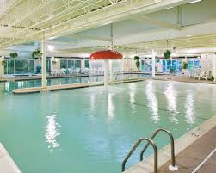
Inside Swimming Pool

Slide 11
Contributor:
Wen H. Chang

Slide 12
Value
Starting Minimum Bid Price:
7-day stay Sun to Sun $500
3-day stay Sun to Wed $300
4-day stay Wed to Sun $400

